Slide 1

WELCOME TO MY PRESENTATION
Presented By
Ajhara Ghosh
CF- Batch 49
Roll: 25

Slide 2
Most of the industries such as textile, paper and printing industries use dyes and pigment to color their products. Dyes degradation products in surface water are reported to be highly carcinogenic. So, it is necessary to treat the textile effluents before discharge into the receiving water. To complete degradation of the dye molecule photolytic degradation method is a good choice. In this method dyes completely mineralizes the organic pollutants into ions. For the photodegradation of different specially dye in the presence of semiconducting oxides such asTiO₂, ZnO under UV or sunlight.
The objectives of the present research are -
To minimize the amount of dye from wastewater for the safety of aquatic life and human health.
To determine the molar absorptivity (ε) value at a fixed λ_{max}.
To observe the effect of catalyst dose, contact time, concentration and light source on the photodegradation of CR by TiO₂.
To explore the optimum catalyst doses for the degradation process.

Slide 3
In recent years, environment pollution had become crucial especially in water pollution. The pollutions of water are mainly caused by large amounts of dyes which are produced from textile, cosmetics, paper, leather, food and other industries. Textile industries are one of the most common industries that consume a lot of water in their processing textile. Wastewater generated by textile industries contains the considerable amount of non-fixed dyes especially azo dyes. It is estimated that 60% of dyes used rising great environmental concern especially in water. The release of dyes into the environment caused serious problems due to their toxic, mutagenic and carcinogenic characteristic of the dye.

Slide 4
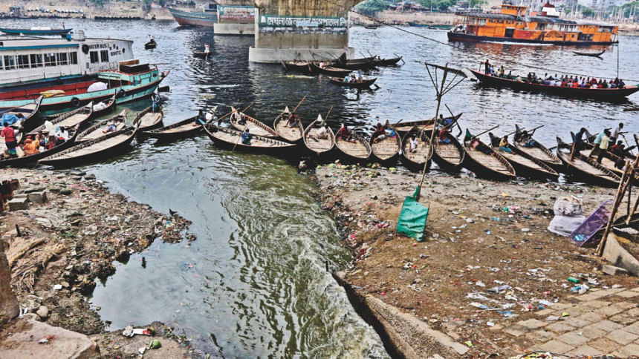
Figure: Mindless dumping of industrial waste and garbage in Buriganga.

Slide 5
Water Pollutants:
Inorganic pollutants: This group consists of inorganic salts, mineral acids, finely-divided metals or metal compounds, trace elements, complexes of metals with organic in natural water, and organometallic compounds.
Organic pollutants: There are many different types of organic pollutants, such as Hydrocarbons, PAH (polyaromatic hydrocarbon) PCB (polychlorobenzene)etc.
Radioactive materials: Nuclear weapons testing in air, leakage from underground nuclear denotations etc.
Thermal pollution
Sediments

Slide 6
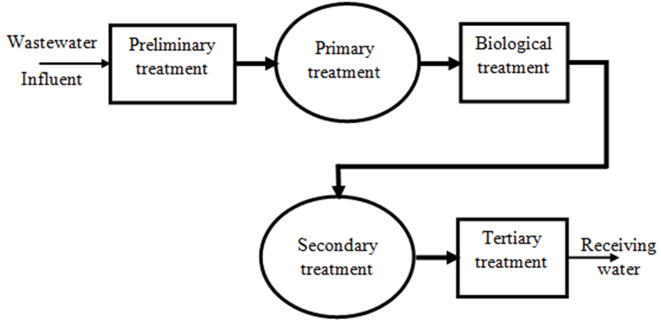
Waste Water Treatment

Slide 7
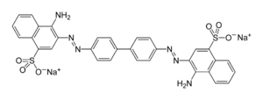
Congo Red
Removal Techniques of Dyes
Physical Method
Adsorption
Reverse osmosis
Ultrafiltration

Slide 8
Chemical Method
Chlorination
Ozonation
Adsorption on organic or inorganic matrices
Precipitation
Photodegradation with photocatalyst
Advanced oxidation processes such as Fenton and Photo-Fenton catalytic reaction, H₂O₂/UV
Biological Method
Microbiological or enzymatic decomposition
Biodegradation

Slide 9
Thank You

